Slide 1

Understanding Chelsea FC’s 2022-2023 Premier League Slump
Presenters
Aditya
Kamal
Arpit
Asheesh
Unraveling the Factors Behind the Decline

Slide 2
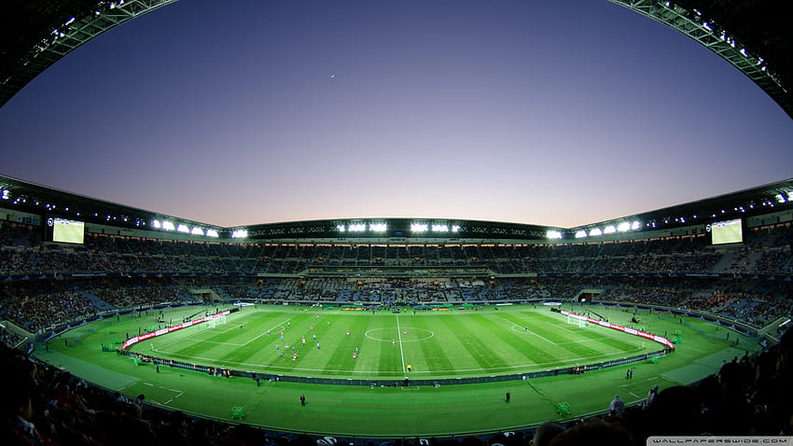
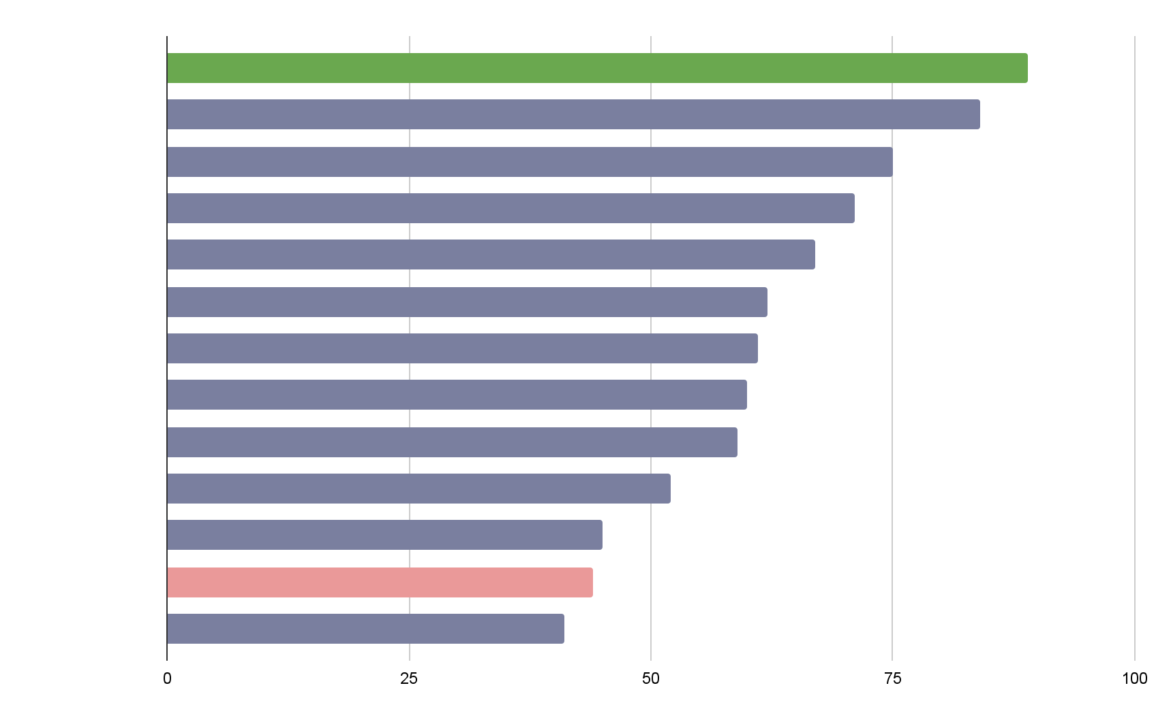
Premier League Standings (2022-2023)
Chelsea FC’s Current Position: 12th Place

Slide 3

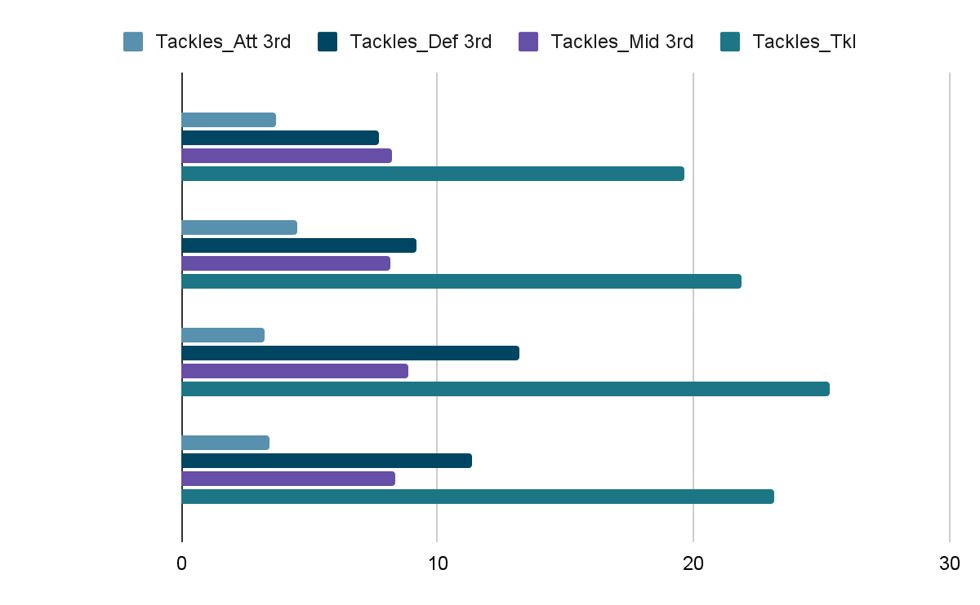
Defensive Performance

Slide 4

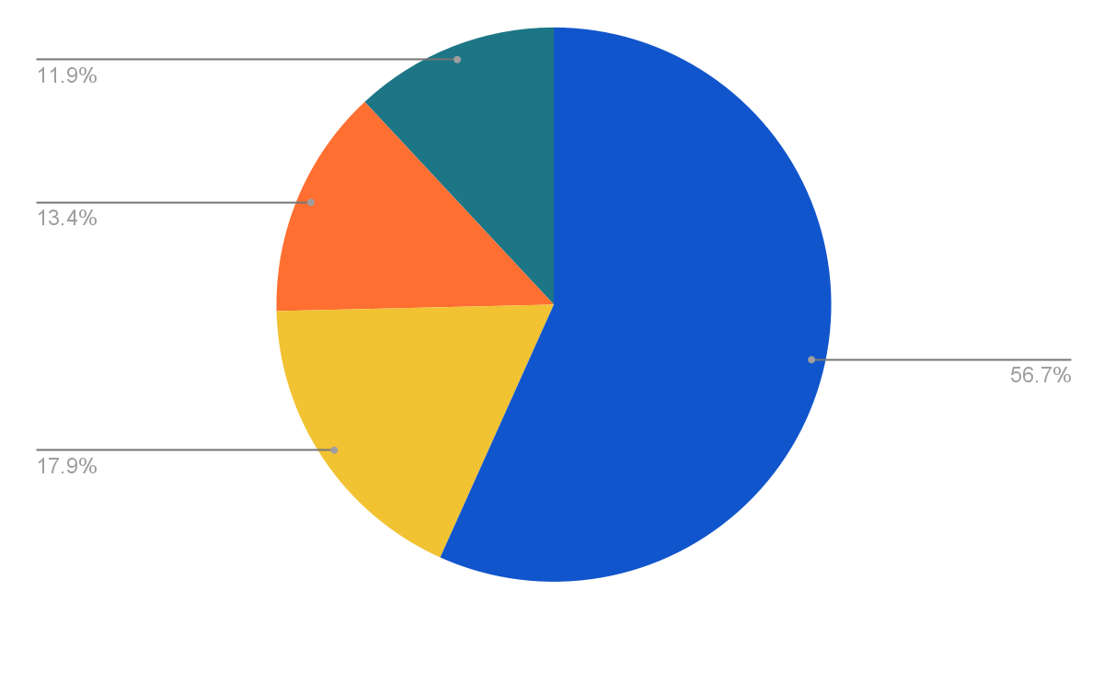
Capitalizing Penalty Opportunities

Slide 5

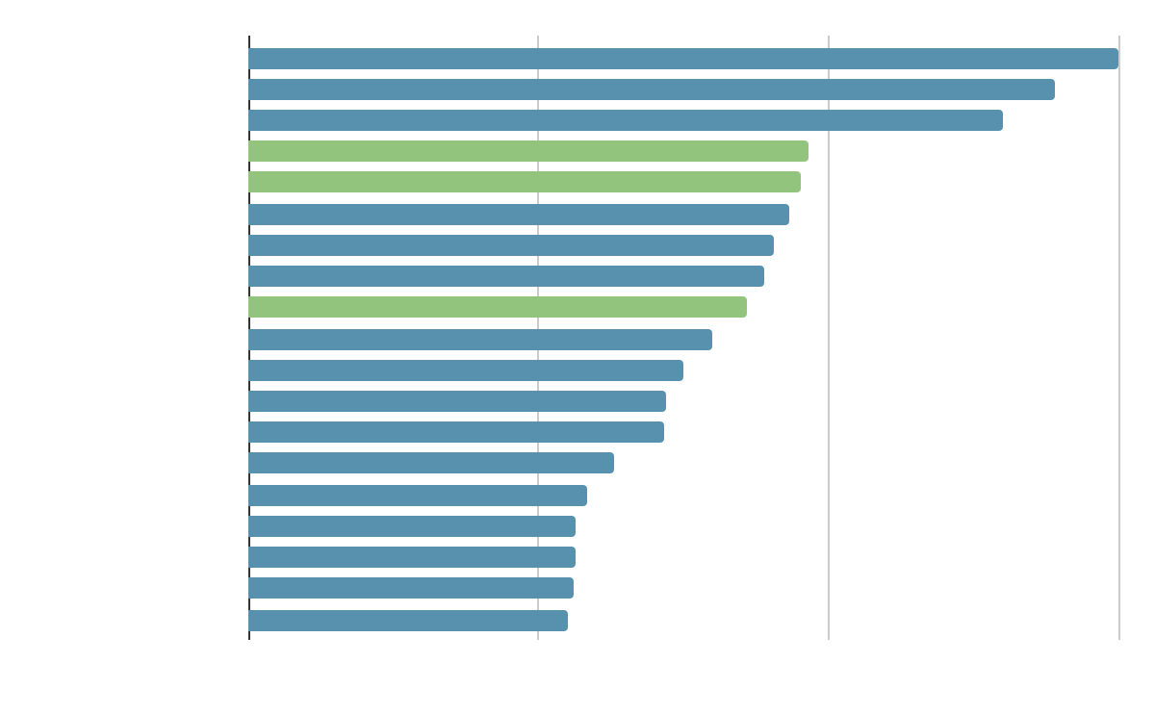
Passing Analysis

Slide 6
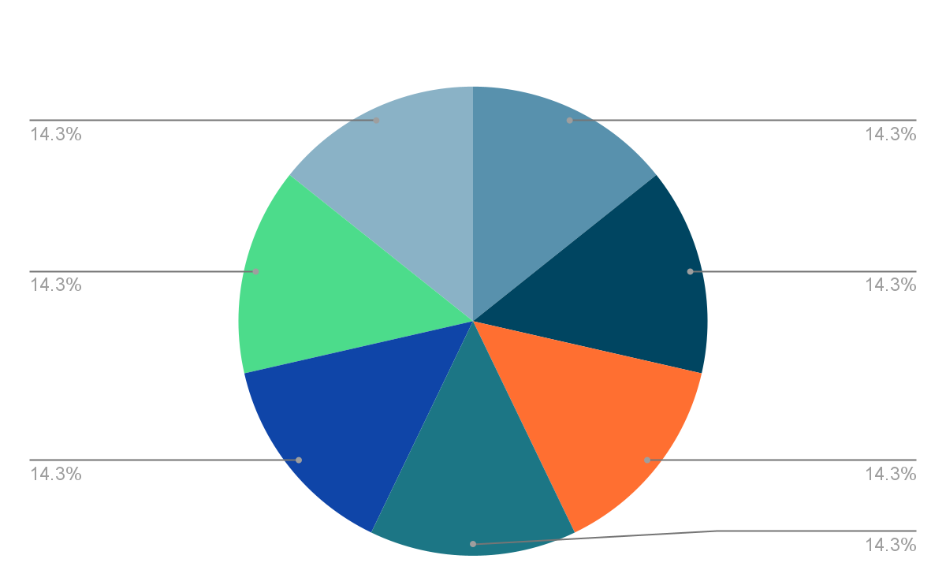
Passing Analysis

Slide 7

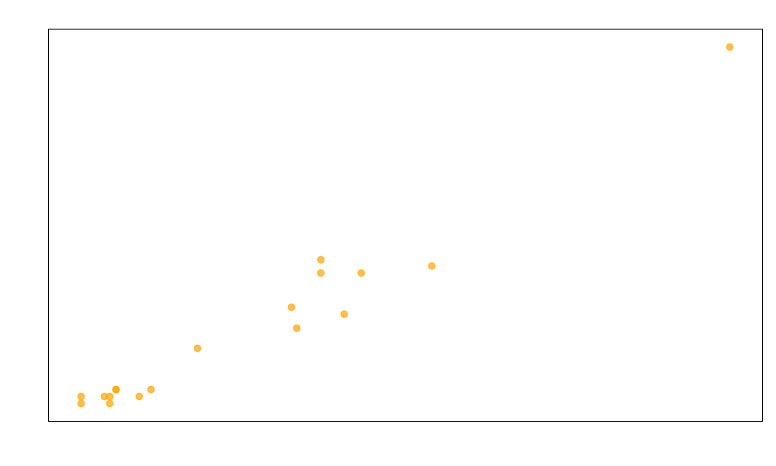
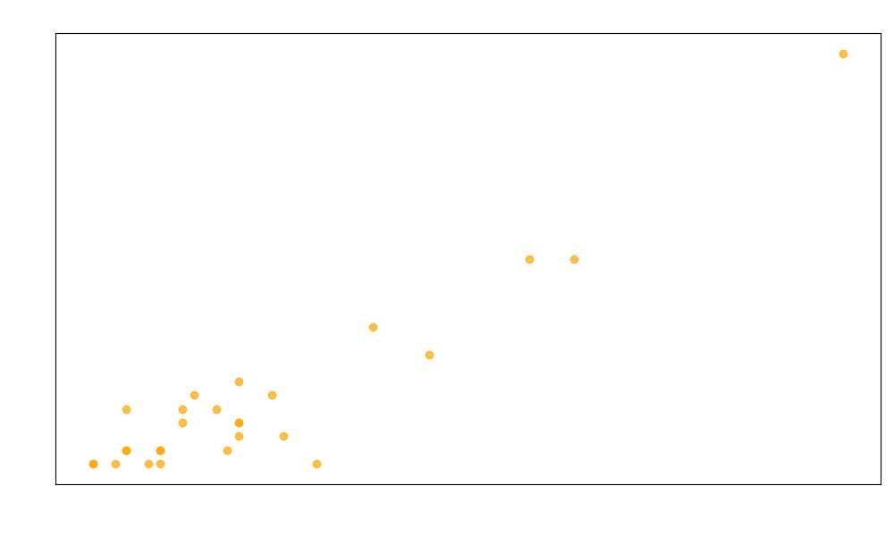
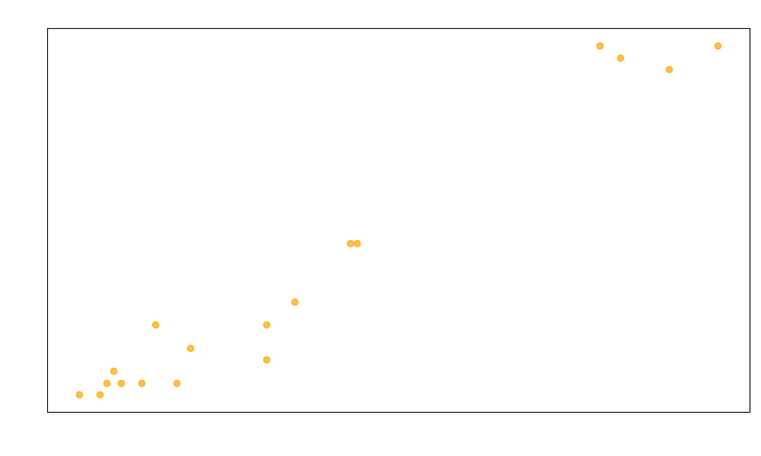
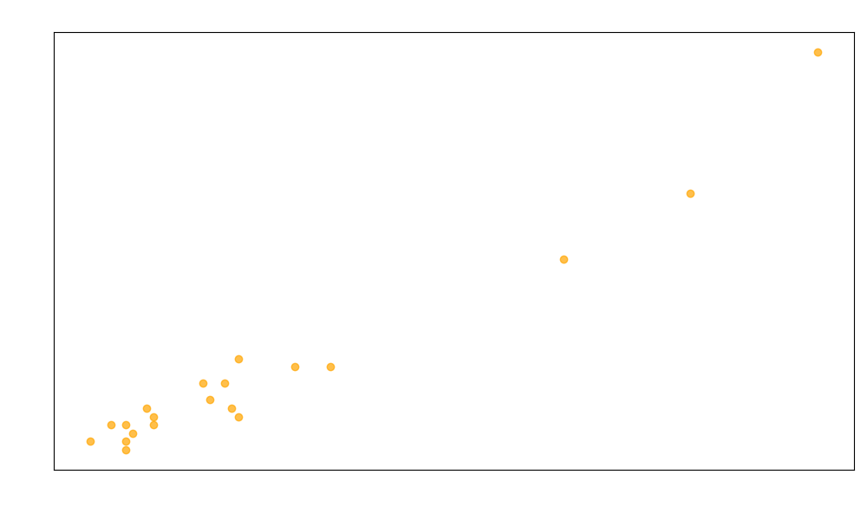
Shooting Analysis

Slide 8

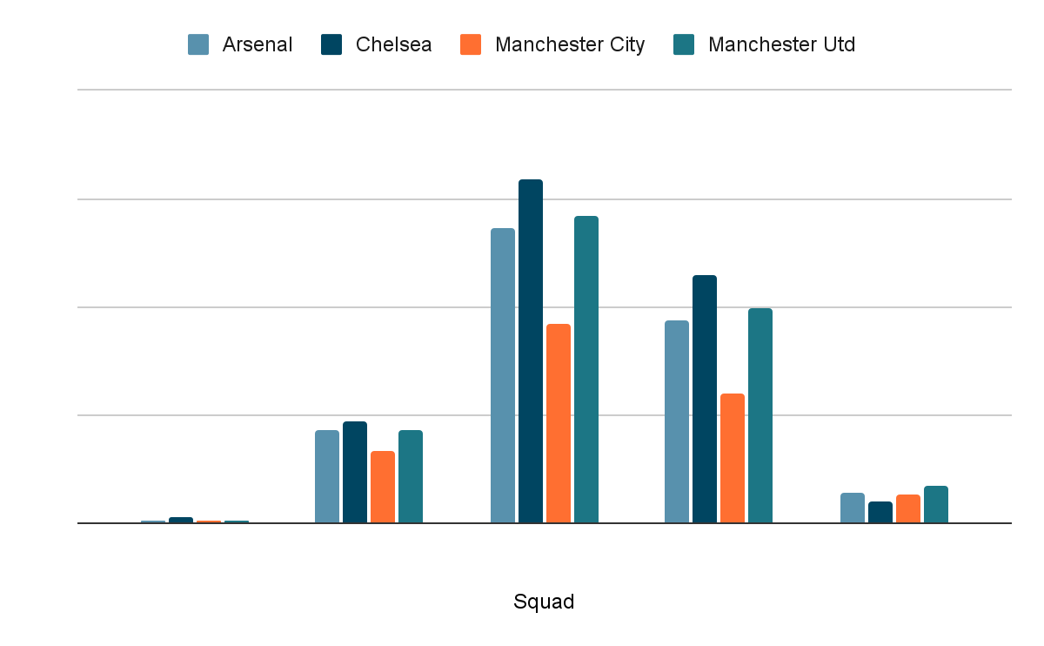
Goalkeeper Analysis

Slide 9

Transfer Targets
Experienced central defender to shore up the defense.
Creative midfielder to improve passing and chance creation.
Clinical striker to enhance goal-scoring efficiency.

Slide 10

Tactical Adjustments
Experiment with different formations to find the most suitable one for the squad's strengths.
Emphasize possession-based football to control games and reduce defensive vulnerability.
Implement high pressing to win the ball back quickly and increase attacking opportunities.

Slide 11

Long-Term Strategy
Invest in youth development to cultivate homegrown talent for the future.
Refine transfer policy to focus on acquiring players who fit the team's playing style and long-term vision.
Establish stability within the club by maintaining continuity in coaching staff and management.

Slide 12

Financial Implications
Financial Planning: Integrate player acquisitions into the club's financial planning process, considering both short-term and long-term financial objectives.
Negotiation Strategy: Develop a strategic negotiation approach to secure favorable transfer deals with other clubs and agents.
Revenue Projections: Project potential revenue impacts associated with improved team performance resulting from successful acquisitions.
Risk Management: Identify and mitigate potential financial risks associated with player acquisitions

Slide 13
Summary and Key Points
Addressing defensive vulnerabilities and enhancing tactical flexibility are crucial for improving performance.
Strategic transfer decisions and long-term planning are essential for sustained success.
Implementing a comprehensive plan with clear responsibilities and monitoring mechanisms is vital for achieving desired results.

Slide 14
Thank You

